Slide 1


Creating a SWYC Screening Plan, Part 2/5
Defining your population
Ellen C. Perrin, MD
R. Christopher Sheldrick, PhD
Kate Mattern, BA

Slide 2
Define your age range
What age range will you screen? At what visits?
      While the AAP only suggests screening at 9, 18, and 30 months, we believe that screening at every visit will be both better for your patients and easier for you.
Consider:
      clinical utility
      legal requirements
      billing
      procedural feasibility
Notes:
Think through what age range you’d like to screen and at what visits. When making this decision, there are multiple factors to consider.
While the AAP only suggests screening at 9, 18, and 30 months, we believe that screening at every visit will be both better for your patients and easier for you. We’ll talk about that more in a moment, but more think about all the factors in play. At what ages do the stakeholders in your practice setting believe screening will be clinically useful? Does your state have any requirements for when children on public insurance must be screened? At what ages can you be reimbursed for screening? What is feasible?

Slide 3
Consider screening at every visit
The SWYC is keyed to the standard periodicity schedule up to 5 ½ years old- we suggest using it at every visit.
  Screening becomes a routine part of care for staff and parents
  Helps to make the child’s development and behavior an expected part of every well child visit
  Easier logistically- no figuring out who gets what
  Frequent conversations build trust
  Missed visits mean missed screens- but more frequent screening compensates for that
Benefits outweigh costs!
Notes:
We strongly encourage you to screen at every well-child pediatric visit from 2 months to 5 years. When you screen at every visit, there is no confusion about what parents need to get the form- staff just know that every child under age 6 should be screened. Staff and parents both become accustomed to the forms, and frequent conversations between providers and patients about the screening questions builds trust and rapport. Plus, screening at every visit provides a fail-safe. While it would be great if every family faithfully attended every visit on the pediatric periodicity schedule right on time, they are in reality sometimes late or missed altogether. One missed screen is less of a problem if they are sure to be screened at every visit which they do attend.
Depending on your state, you may or may not be able to be reimbursed for screening at all of these visits. We understand that there are costs to screening. Usually this includes both the cost of your staff’s time and the costs of the forms themselves. Because the SWYC is free of charge, at least one of those costs can be removed from your decision. We would argue that the costs of staff time are outweighed by the benefits of ease and improved care- and that staff time may actually be somewhat reduced by making screening such an automatic part of your processes.

Slide 4
What languages will you have available?
What languages does your patient population require?
As of November 2016:
  SWYC is available in English, Spanish, Portuguese, Burmese and Nepali
  Yoruba, Arabic, French, Khmer, and Haitian Creole translations are in-process
Notes:
After you’ve defined an age range, think through what languages you will have available. As of this recording in November 2016, the SWYC is available in English, Spanish, Portuguese, Burmese and Nepali. Yoruba, Arabic, French, Khmer, and Haitian Creole translations are in-process.

Slide 5
Language logistics
Note that validation research has only been completed on the English forms. Spanish research is underway, but scoring should be interpreted with caution for non-English forms
Consider what you will do when a) the needed language is not available or b) there are issues with literacy, in any language
Notes:
It’s worth noting that validation research has thus far only been completed on the English forms, so scoring for all other languages should be interpreted with caution. Research on the Spanish language forms is currently underway at the Children’s Hospital of Philadelphia.
You may also want to consider what you will do when the needed language is not available or there are issues with literacy, whether or not they are related to language spoken. For parents who are not sufficiently literate to complete SWYC forms independently, you may want to have private space available for staff to read the SWYC aloud, providing as little interpretation as possible so as to minimize the amount completing the screen aloud may influence parent responses.

Slide 6
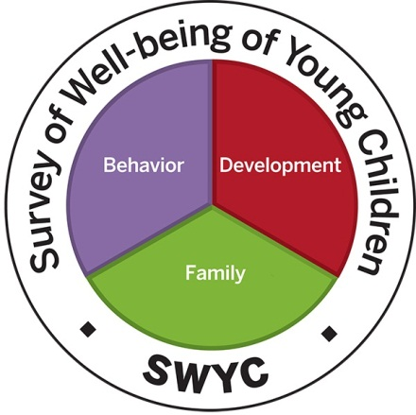
We’d appreciate your feedback on this Powerpoint!
Answer two quick satisfaction questions here: https://www.surveymonkey.com/r/XQFBCPD
Notes:
Thanks for listening. You may wish to continue to part three of this series to learn about building your screening infrastructure.

