Slide 1
Creating a SWYC Screening Plan, Part 3/5 Building your infrastructure
Ellen C. Perrin, MD
R. Christopher Sheldrick, PhD
Kate Mattern, BA

Slide 2
Three basic choices, but lots of variation
Screening can be done:
By paper
Electronically
Some combination of the two (for example, forms administered on paper, then entered into EMR)
Lots of variation within each option
Notes:
There are three basic ways that practices implement the SWYC- in an entirely pen and paper system, an entirely electronic system, or in a combination of the two (for example, administering forms on paper but then entering the data into an electronic system). There is a lot of variation within each general category.

Slide 3
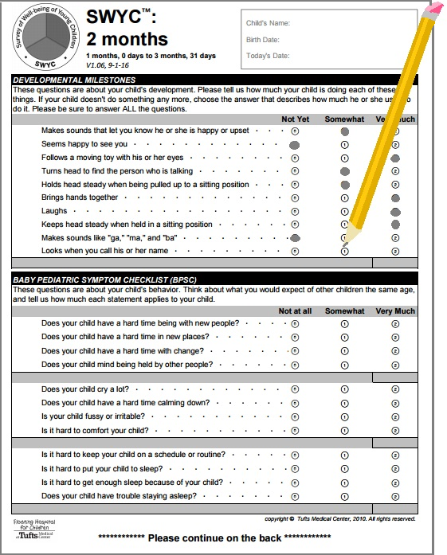
Paper-based systems
Paper forms are available for free download at www.theswyc.org
How will you store the forms so that they are easy to find?
How will you make sure it is clear to staff what age range each form covers?
Notes:
Paper forms have some advantages. There are no computerized systems to break down, and the process is intuitive for parents. While it doesn’t happen a lot, we do make updates to the SWYC occasionally, and it is easy to update a paper-based system with new forms.
On the negative side, using an entirely paper-based system means that there is more staff work to do, like calculating age to select the appropriate form and scoring.
If you do go with a paper-based system, it is worth taking the time to think through how you will store your forms and how you will make it clear to staff what age range each form covers.

Slide 4
2 month English
(1 month, 0 days to 3 months, 31 days)
4 month English
(4 months, 0 days to 5 months, 31 days)
6 month English
(6 months, 0 days to 8 months, 31 days)
9 month English
(9 months, 0 days to 11 months, 31 days)
12 month English
(12 months, 0 days to 14 months, 31 days)
15 month English
(15 months, 0 days to 17 months, 31 days)
18 month English
(18 months, 0 days to 22 months, 31 days)
24 month English
(23 months, 0 days to 28 months, 31 days)
30 month English
(29 months, 0 days to 34 months, 31 days)
36 month English
(35 months, 0 days to 46 months, 31 days)
48 month English
(47 months, 0 days to 58 months, 31 days)
60 month English
(59 months, 0 days to 65 months, 31 days)
Notes:
These simple mechanics of how your print outs are organized can really make or break your screening system. A practice partner in the greater Boston area, for instance, created a multi-compartment organizer labeled with the age range for each form. It makes it easy to pick the correct form, and when forms are running low, that is also visible at a glance. You could also consider using different colored paper for different ages.

Slide 5
Electronic-based systems
Some practices have built the SWYC into electronic patient portals or use the Epic foundation build
Will parents complete the electronic form on their home computer? At a kiosk in the office? On a tablet?
As of this time (November 2016), most of the SWYC Milestones are already available to access in Epic- ask your Epic rep
We anticipate that the other SWYC components will be available in Epic in the spring of 2017
Most users do not need a license to incorporate the SWYC into a new electronic system, but some large or corporate users may. Consult our website for more information and email us at theswyc@gmail.com if you are not sure whether or not your build requires a license.
Notes:
Electronic systems also have pros and cons. There is more opportunity for glitches with equipment, and maintaining ipads or kiosk computers can be expensive. However, electronic systems do take a lot of the work out of administering screening- these systems can automatically calculate age and select the appropriate form, score forms, and present results longitudinally to providers.
If parents will be completing the SWYC electronically, you’ll similarly want to think through how you will create that build and what technology is needed.
As of this recording in November 2016, most of the SWYC Milestones are available in EPIC’s foundation build. If you are interested in accessing the parts of the SWYC that are available in Epic, contact your Epic rep. We anticipate that the rest of the SWYC will be available in Epic’s foundation build sometime in the spring of 2017.
Most users do not need a license to incorporate the SWYC into an electronic system, but some large or corporate users may. Consult our website for more information and email us at theswyc@gmail.com if you are not sure whether or not your build requires a license

Slide 6
Combination systems
Will scoring be done electronically or manually?
If you’re administering the SWYC electronically, do the results automatically sync to the child’s chart or do they need to be printed or hand-entered in some way?
If completing on paper, is it scanned to the chart? Is the data entered into an electronic chart? Are the paper forms just filed in hard copy?
Notes:
How a parent completes the SWYC is one question, and how the SWYC is scored and results are stored are another. If the SWYC is completed electronically, will the results be automatically scored? Will the data be automatically added to the chart? If the SWYC is completed on paper, how will that information be entered into the chart? Think through not only how the SWYC will be administered, but how the information will ultimately be entered into the patient’s documentation.

Slide 7
We’d appreciate your feedback on this Powerpoint!
Answer two quick satisfaction questions here:
https://www.surveymonkey.com/r/XQ57LJ2
Notes:
Thanks for listening. You may wish to continue to part four of this series to learn about assigning roles and training your staff.

